Slide 1
Digital Sovereignty in Practice
Leveraging In-Band Telemetry and ML for a Responsible Internet

Slide 2
Building a Responsible and Resilient Internet
INT, IN-RL and IBN for a Responsible Internet
Preserving Digital Autonomy
Ensure societal autonomy by protecting critical systems from external manipulation and surveillance.
User Empowerment and Choice
Enable individuals and critical service providers to select and control the equipment managing their data.
Data Sovereignty
Allow users to define clear requirements for their data, including trusted networking hardware and geographic preferences.
Transparency and Accountability
Provide mechanisms for users to verify operator integrity and effectively trace incidents or cyber-attacks to their origins.
Resilient and Responsible Internet
Promote an internet infrastructure that is resilient, secure, and aligned with users’ privacy and security expectations.

Slide 3
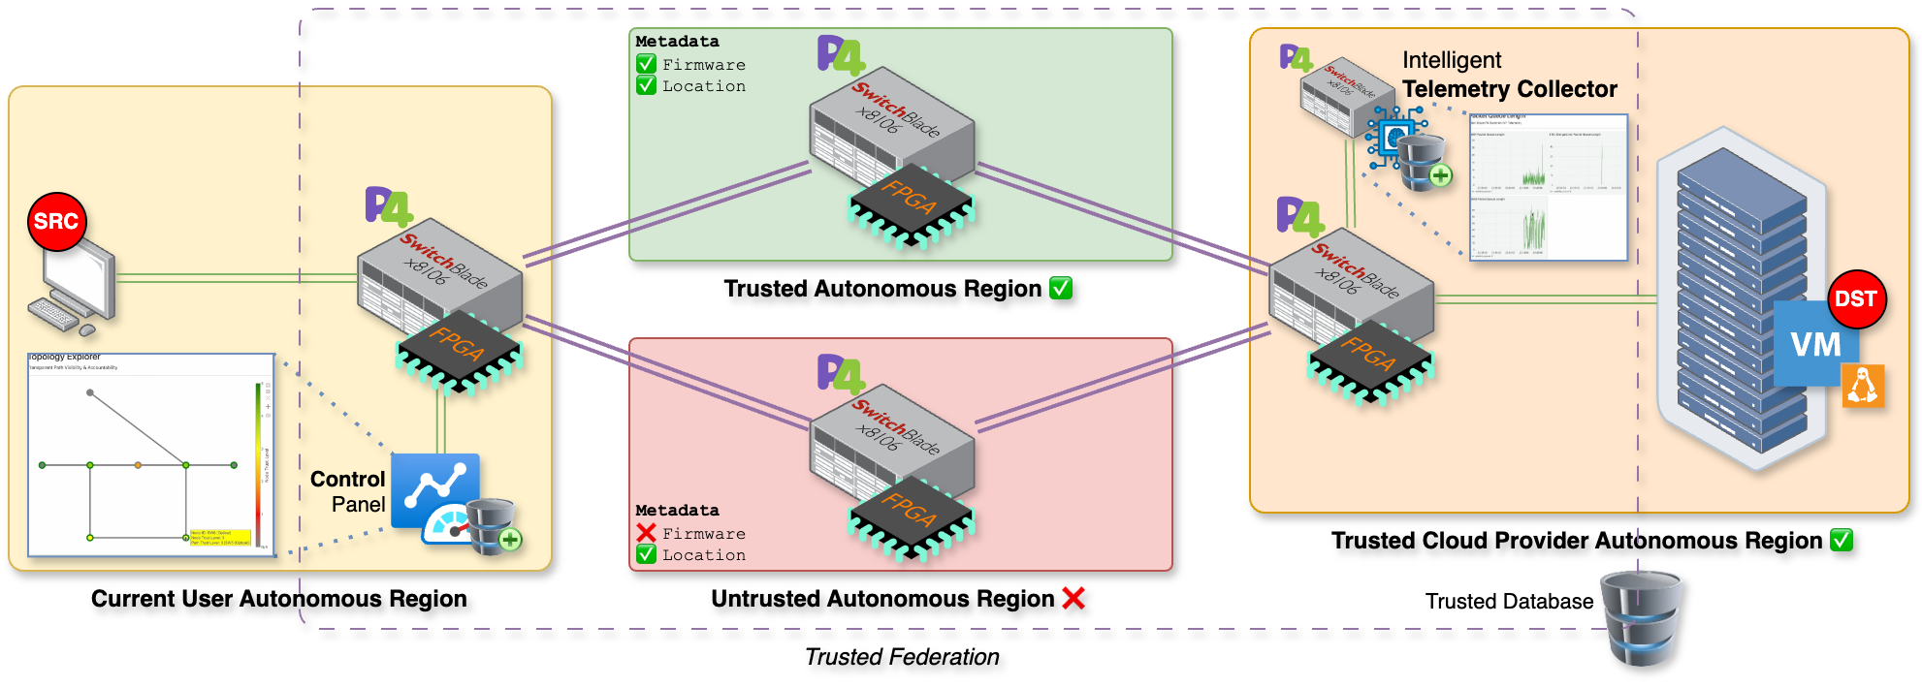
Network element trust level
INT, IN-RL and IBN for a Responsible Internet

Slide 4
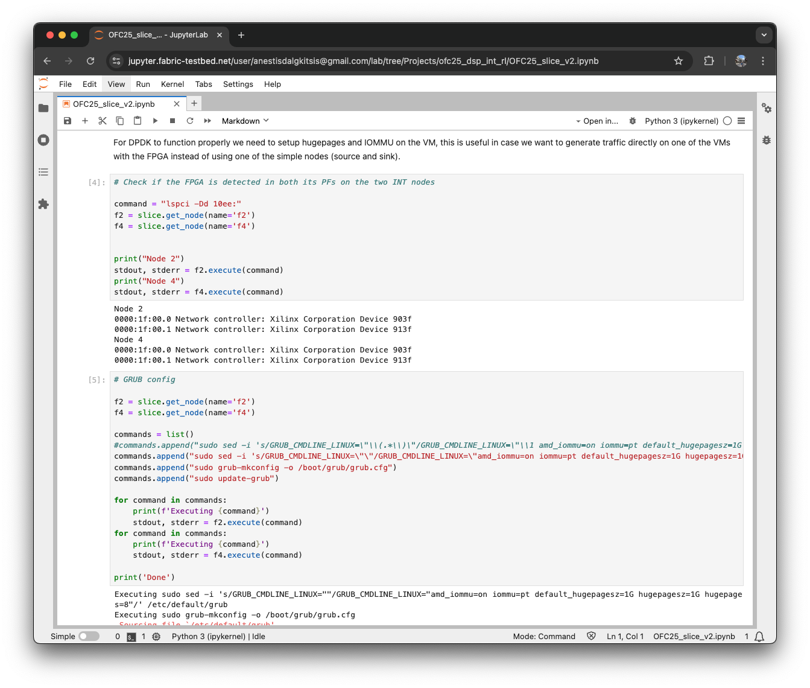
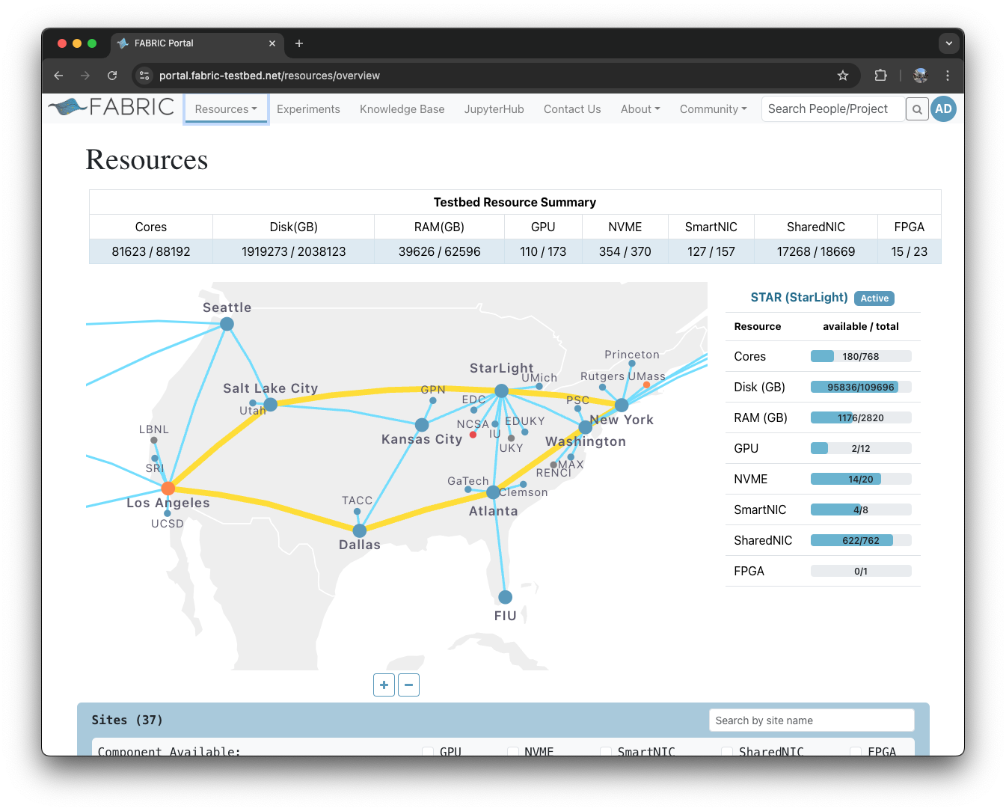
Proof-of-concept
Demonstrator Description & Operation

Slide 5
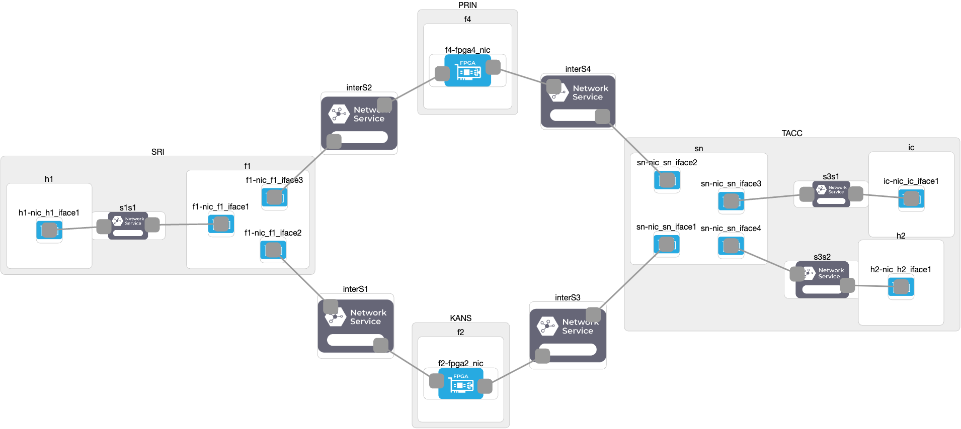
FABRIC TESTBED
Poc demo description

Slide 6
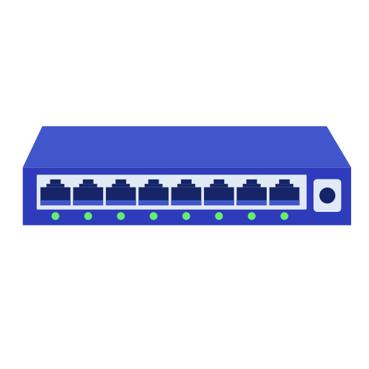
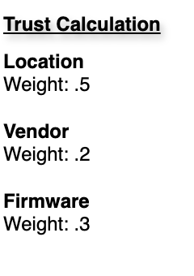
Network element trust level
Poc demo description
Trust LeveL
interactions with the other network entities
location
firmware version
level of hardware hardening
etc

Slide 7
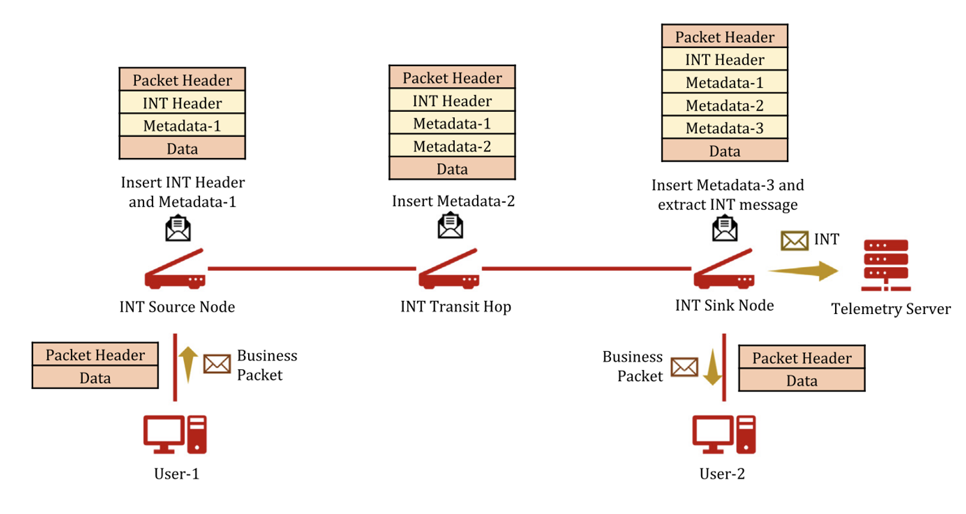
In-band network telemetry
Poc demo description

Slide 8
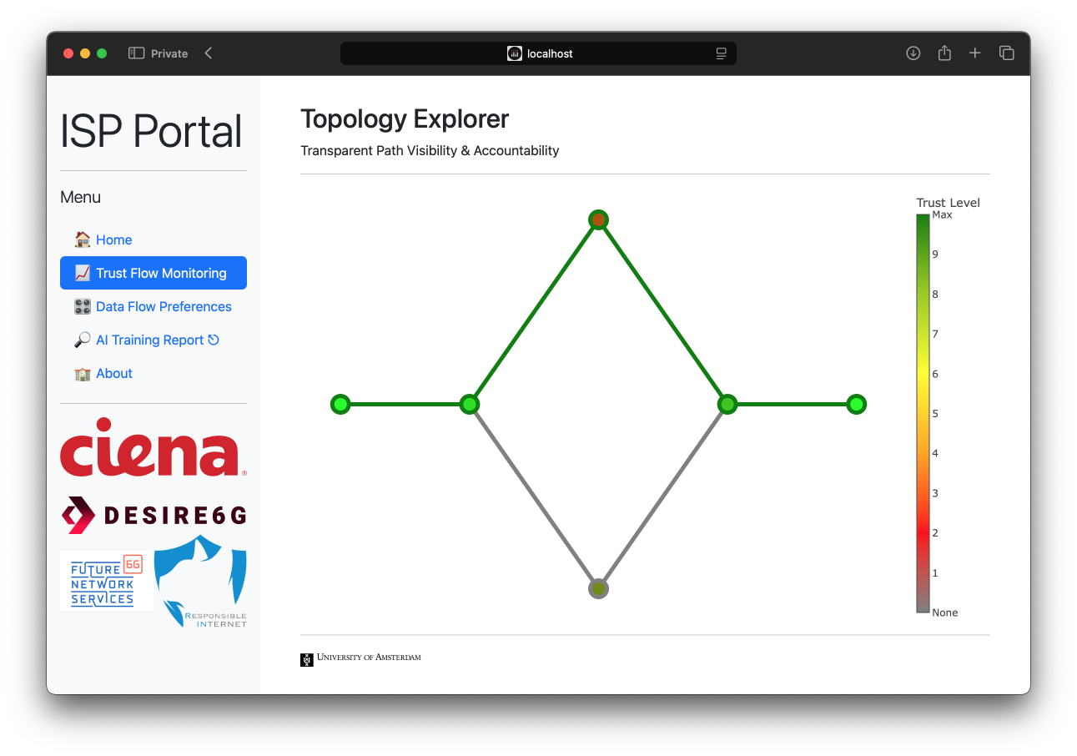
Poc demo description

Slide 9
Poc demo description

Slide 10
Scenario I
Autonomous Learning-driven In-network Control

Slide 11
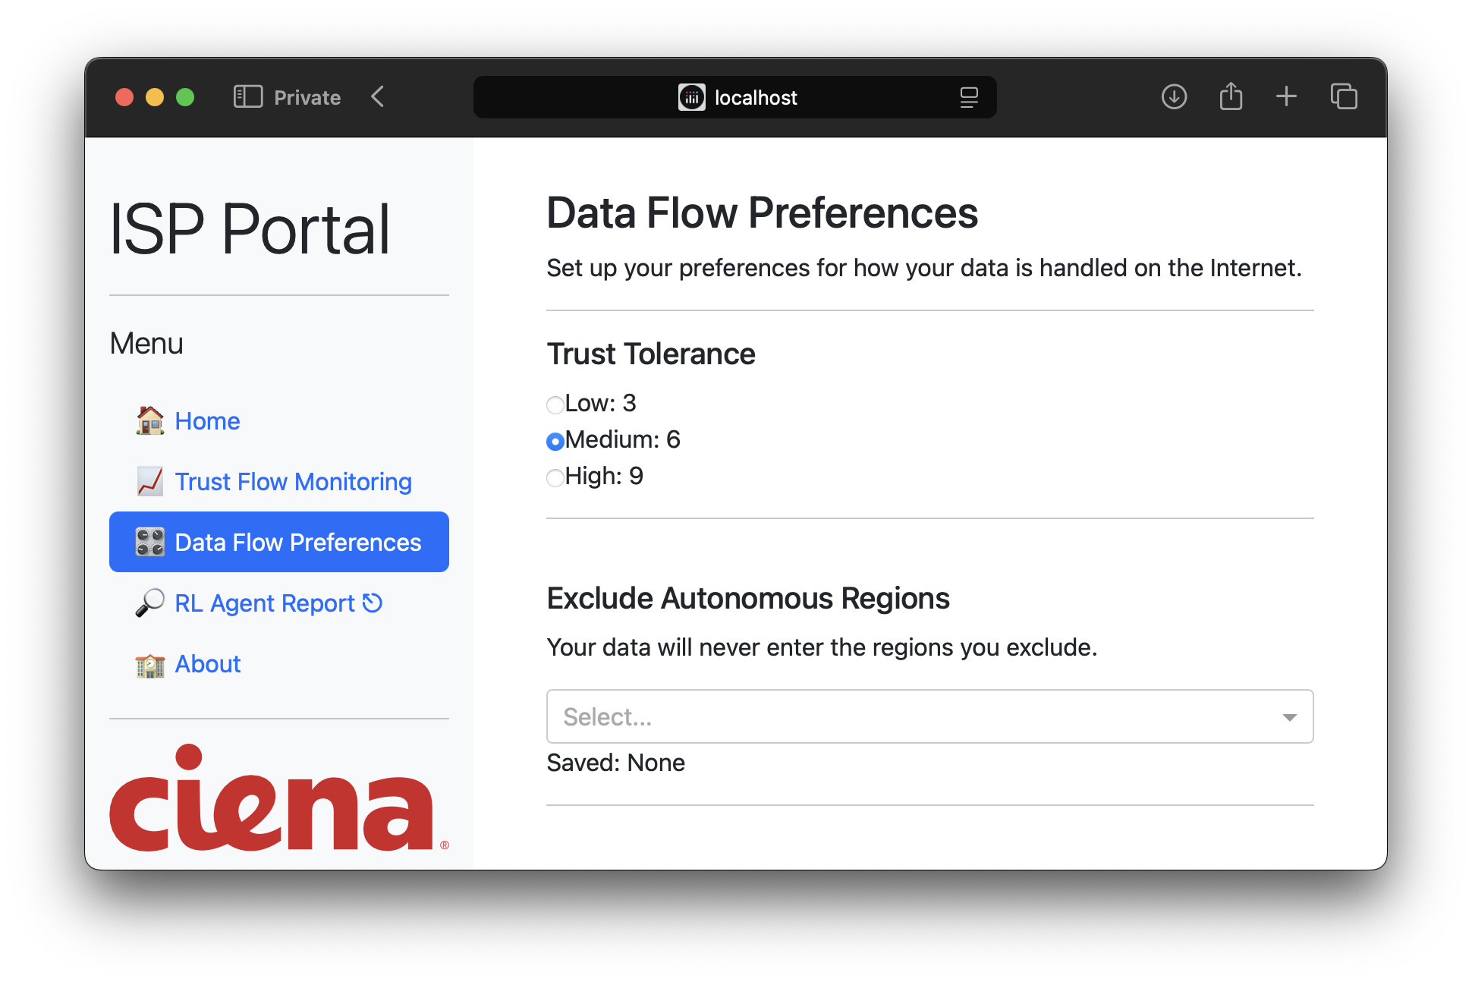
Autonomous Learning-driven In-network Control
Demo: scenario II

Slide 12
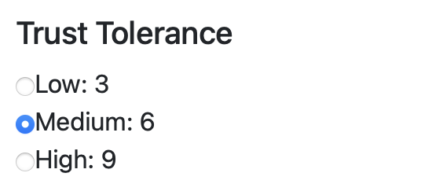
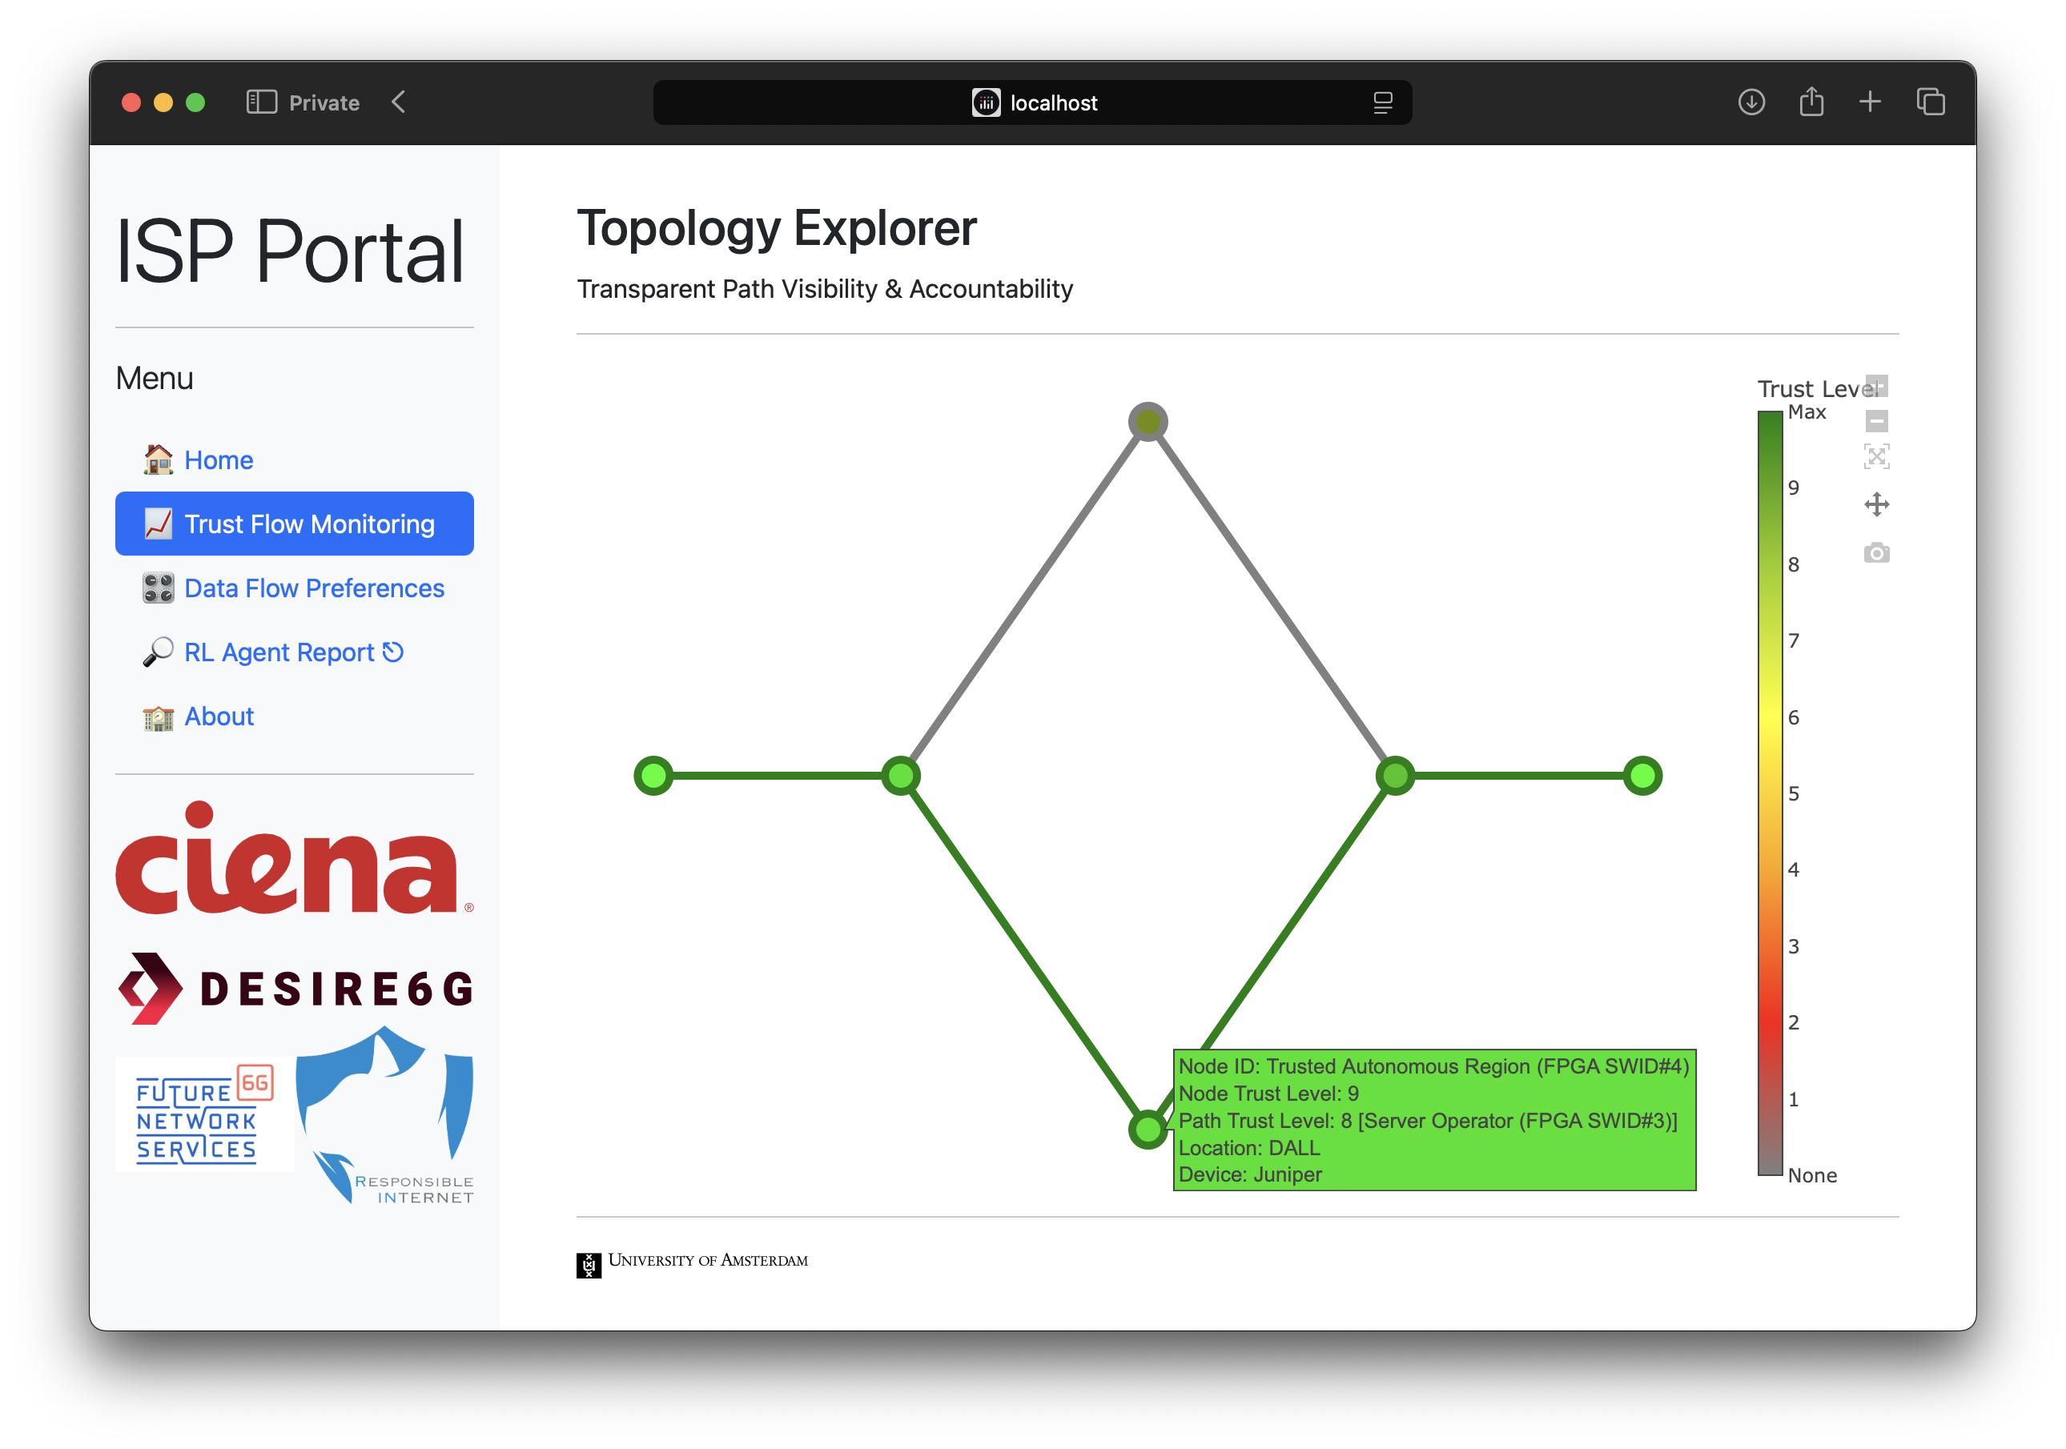
Autonomous Learning-driven In-network Control
Demo: scenario II

Slide 13
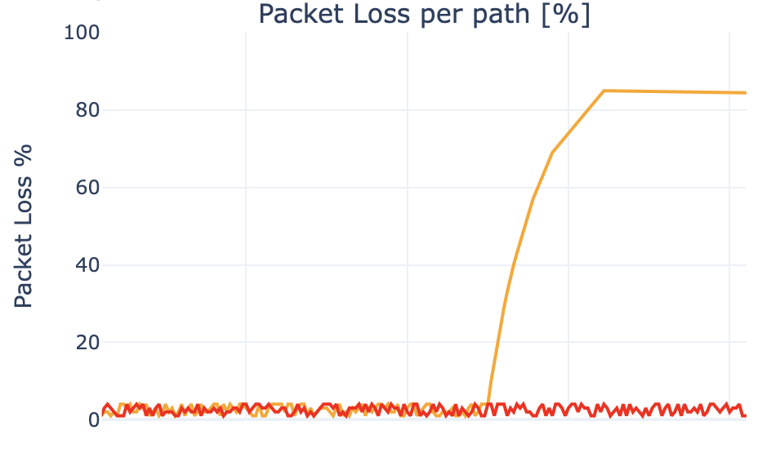
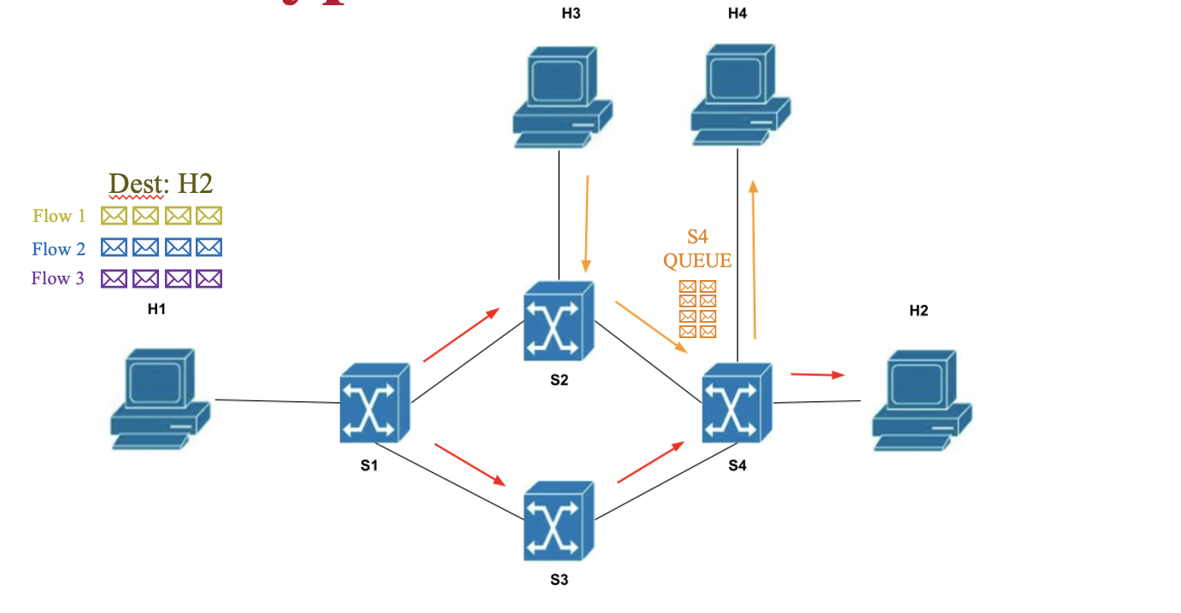
Autonomous Learning-driven In-network Control
Demo: scenario II
Attack!
Attack!

Slide 14
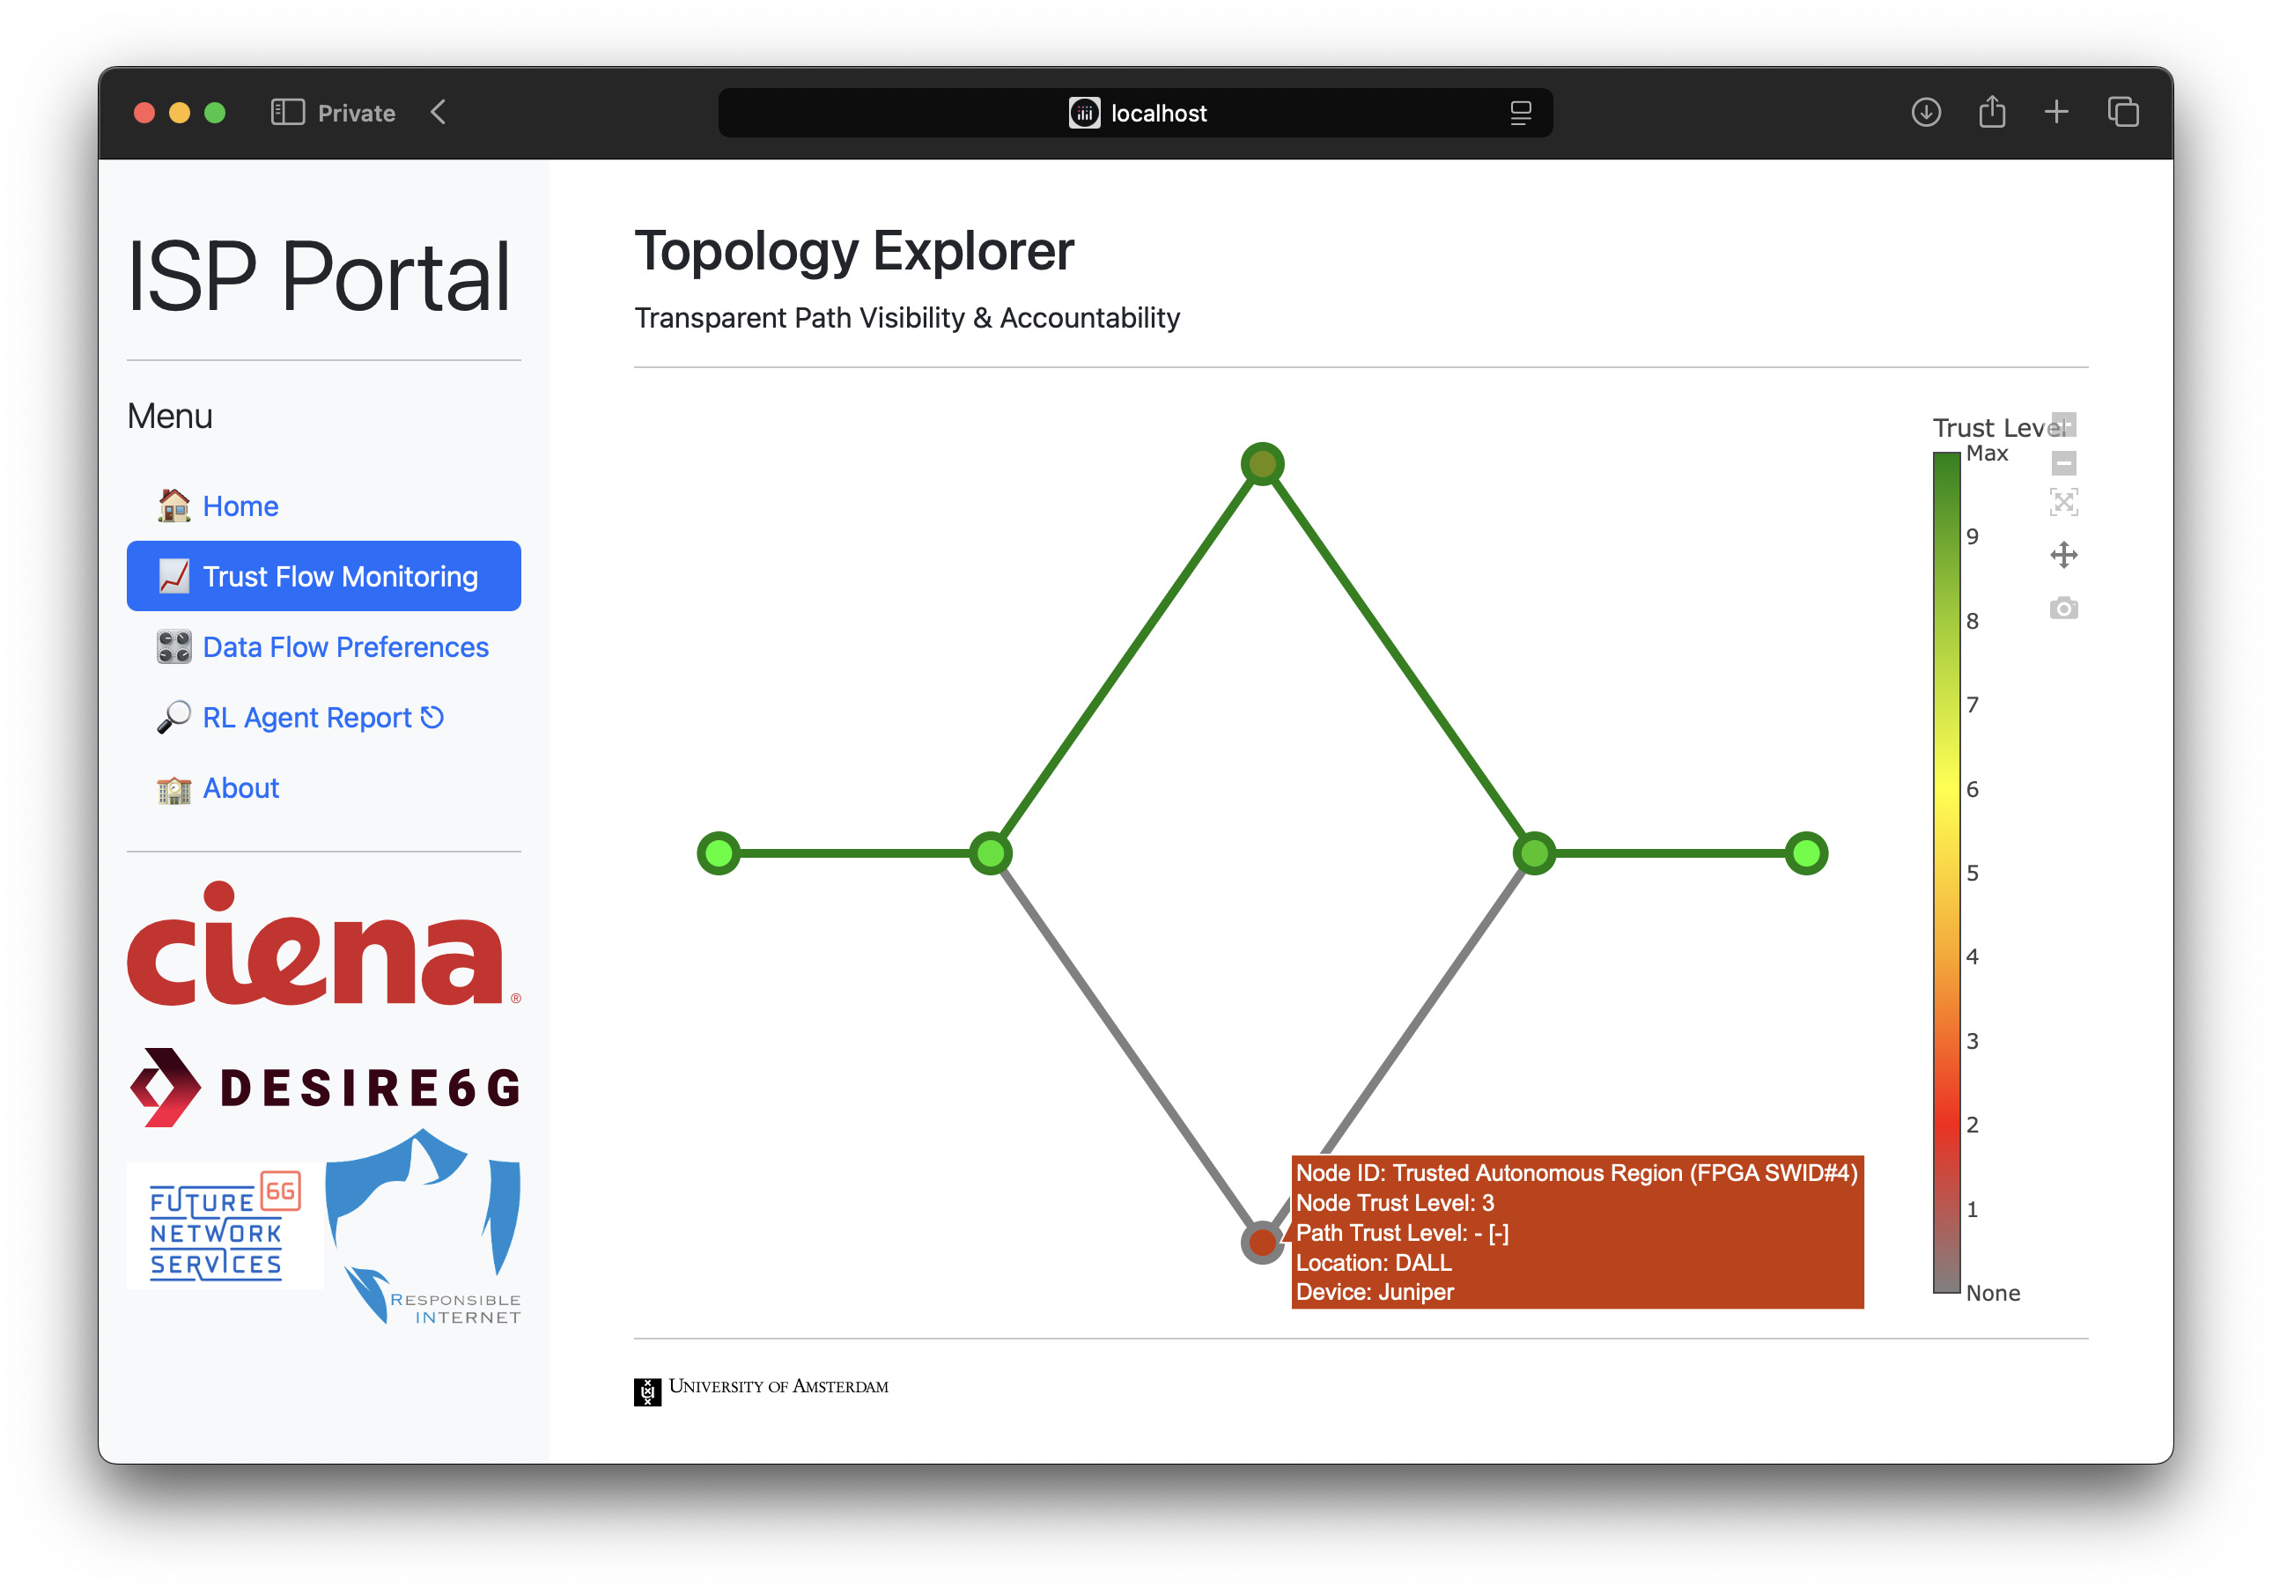
Autonomous Learning-driven In-network Control
Demo: scenario II
Attack!

Slide 15
Autonomous Learning-driven In-network Control
Demo: scenario II
Attack!

Slide 16
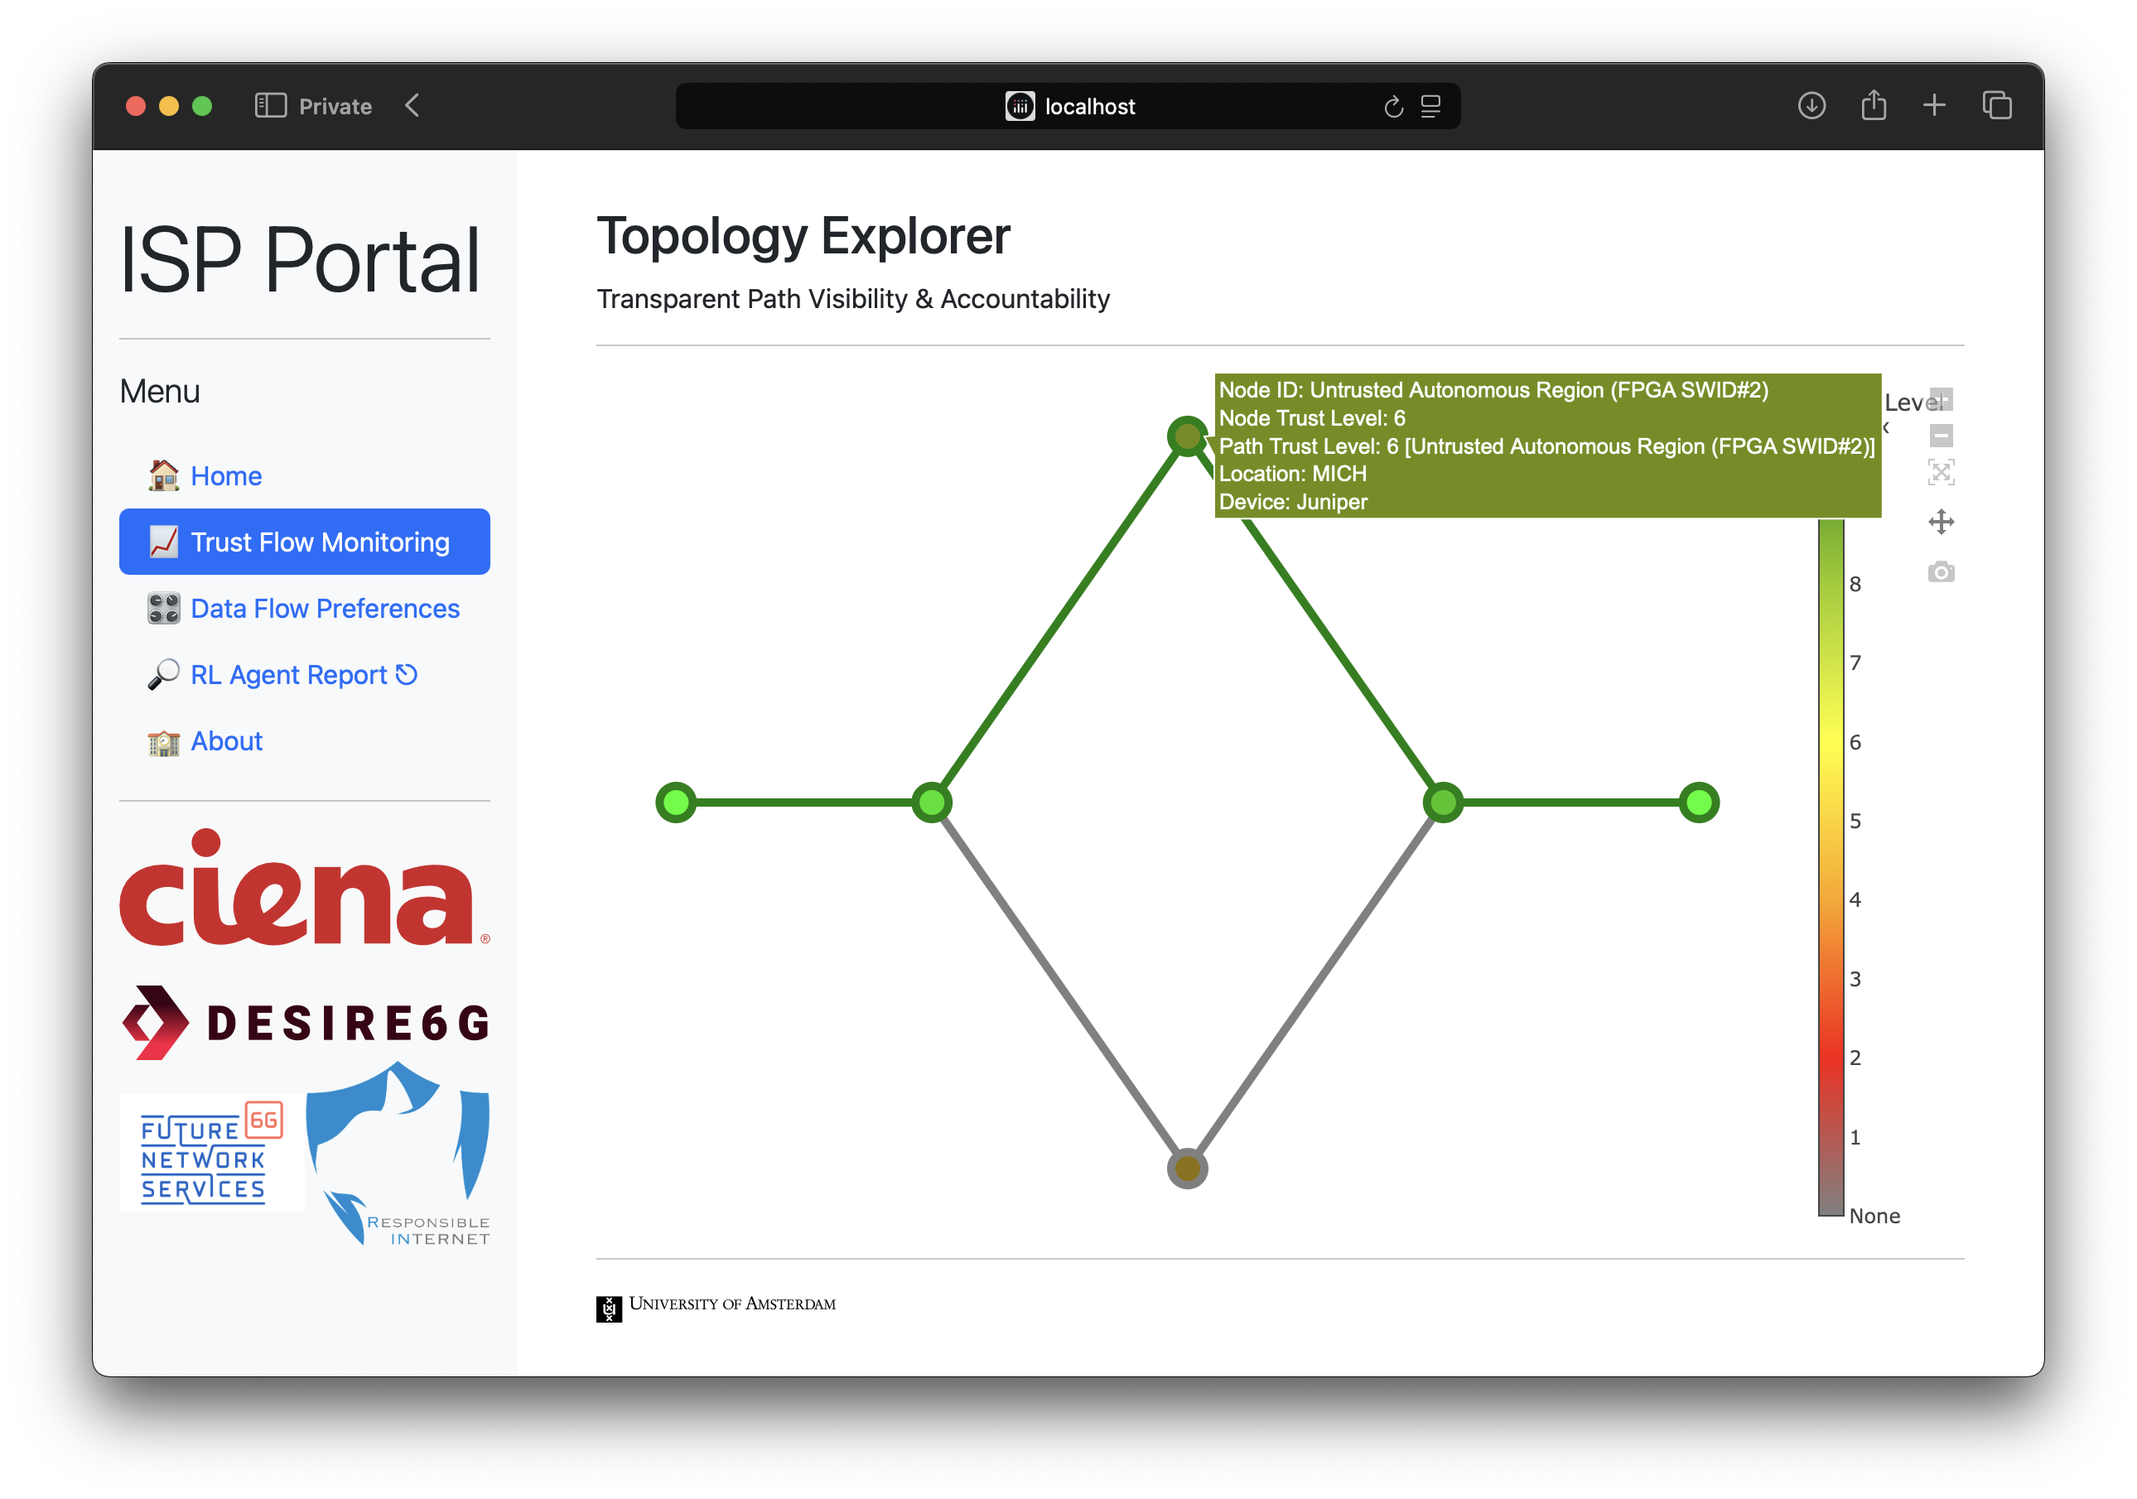
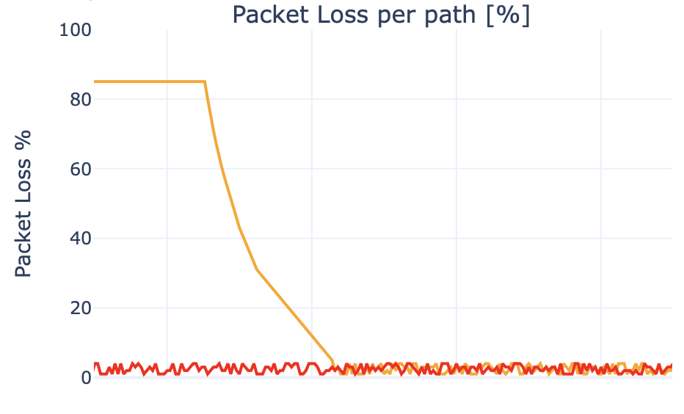
Autonomous Learning-driven In-network Control
Demo: scenario II

Slide 17
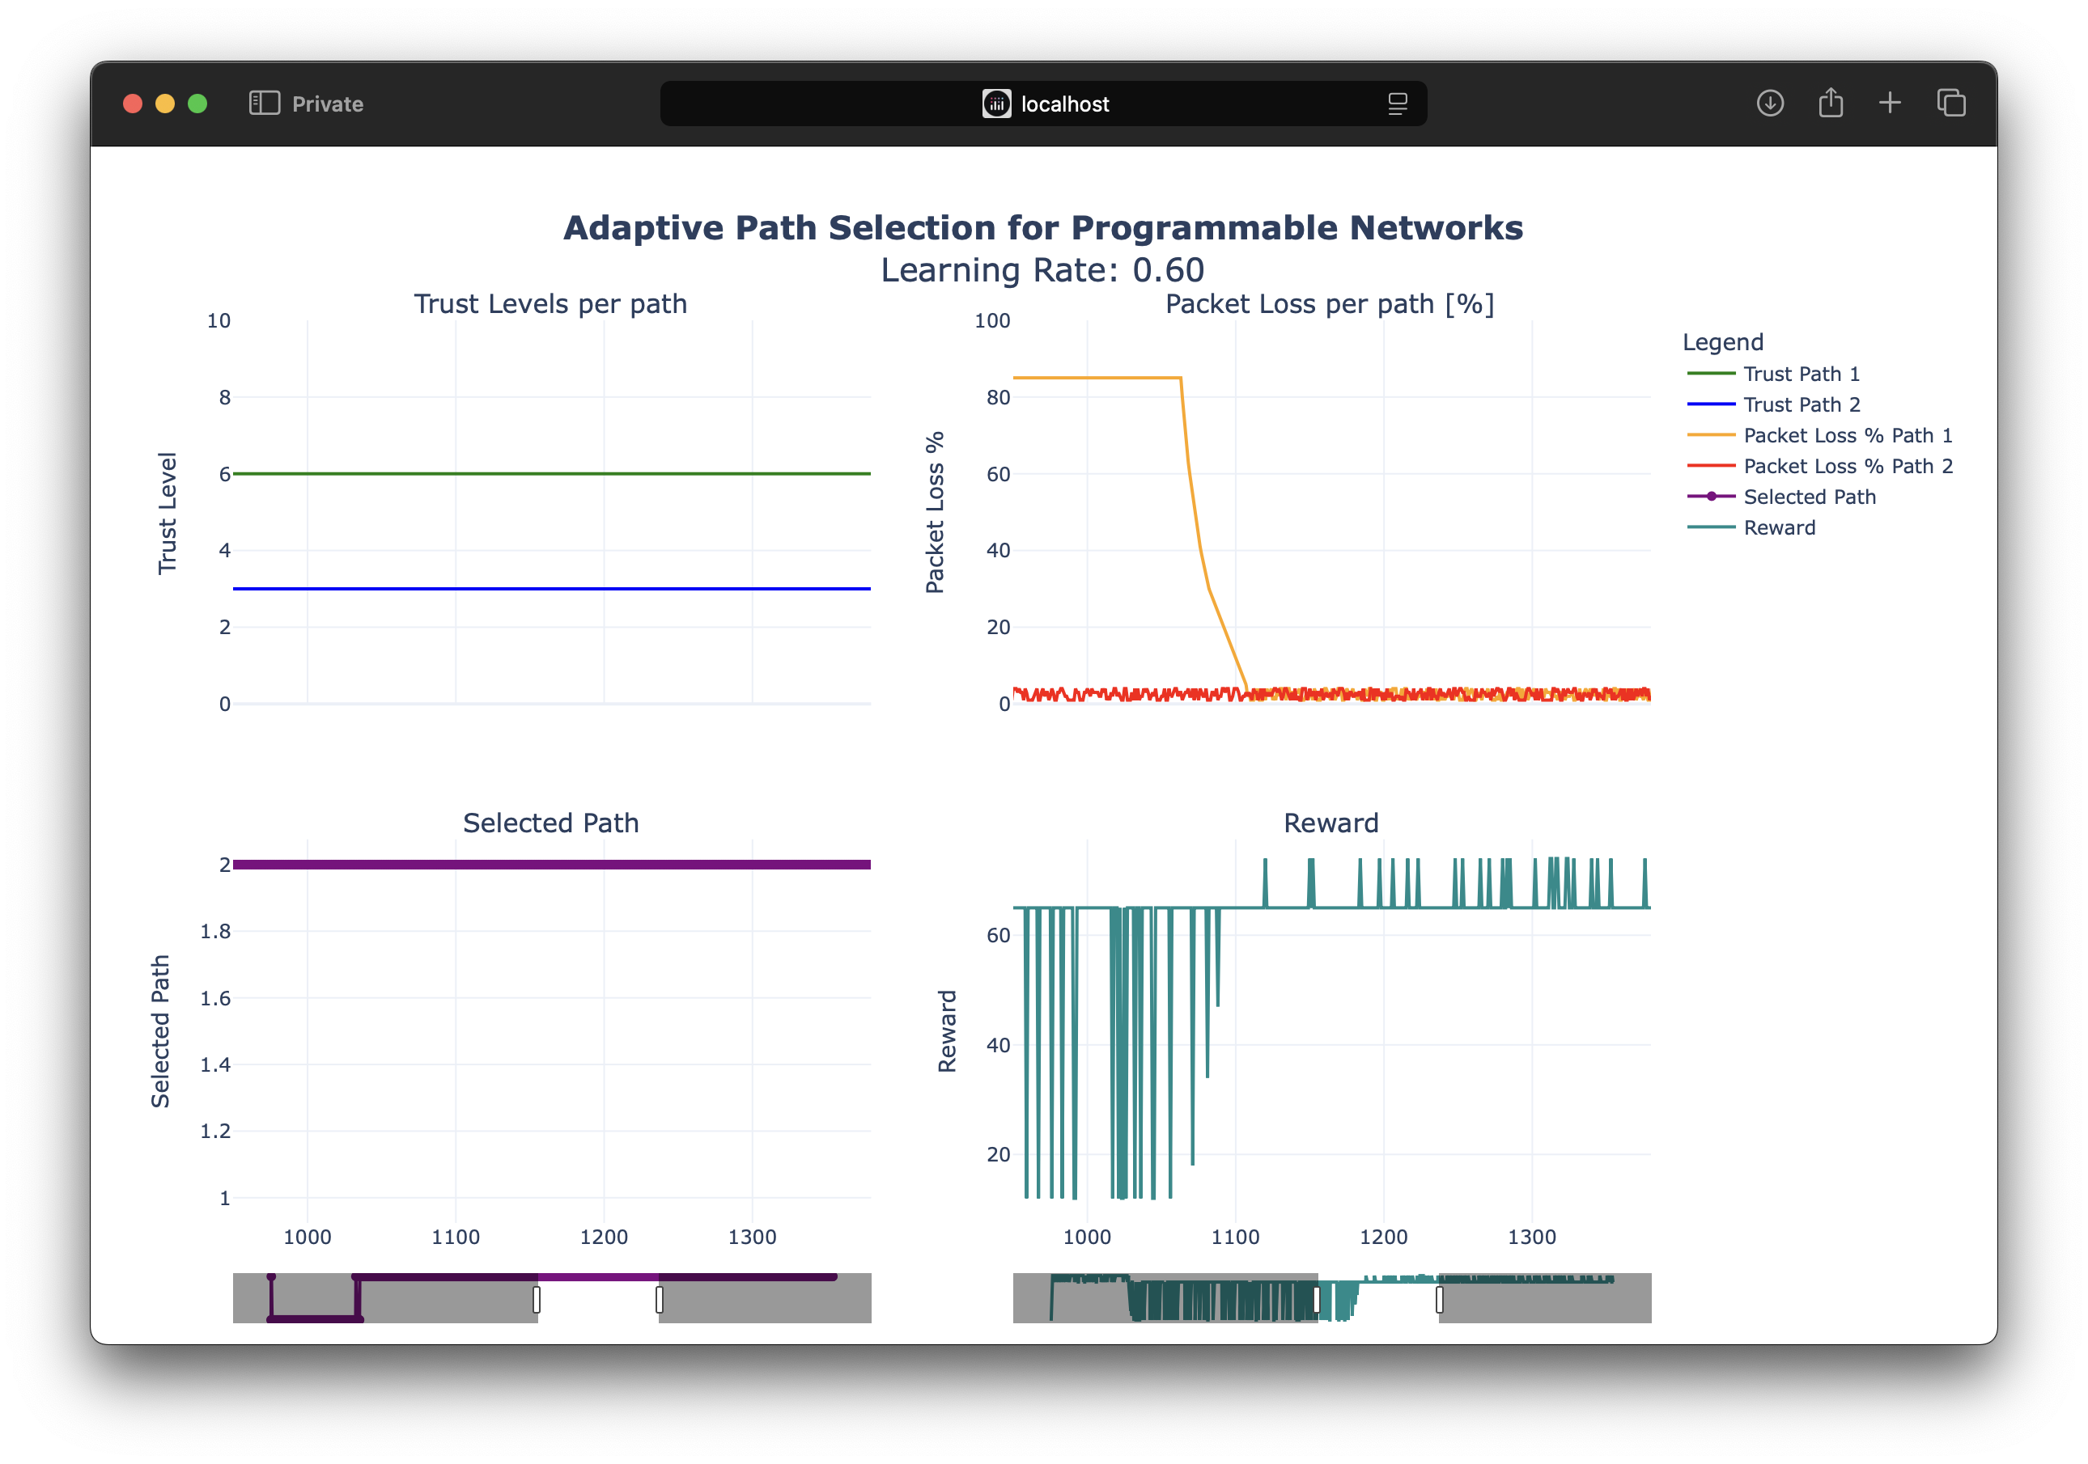
Autonomous Learning-driven In-network Control
Demo: scenario II

Slide 18
Scenario II
User Intent-driven network Control

Slide 19
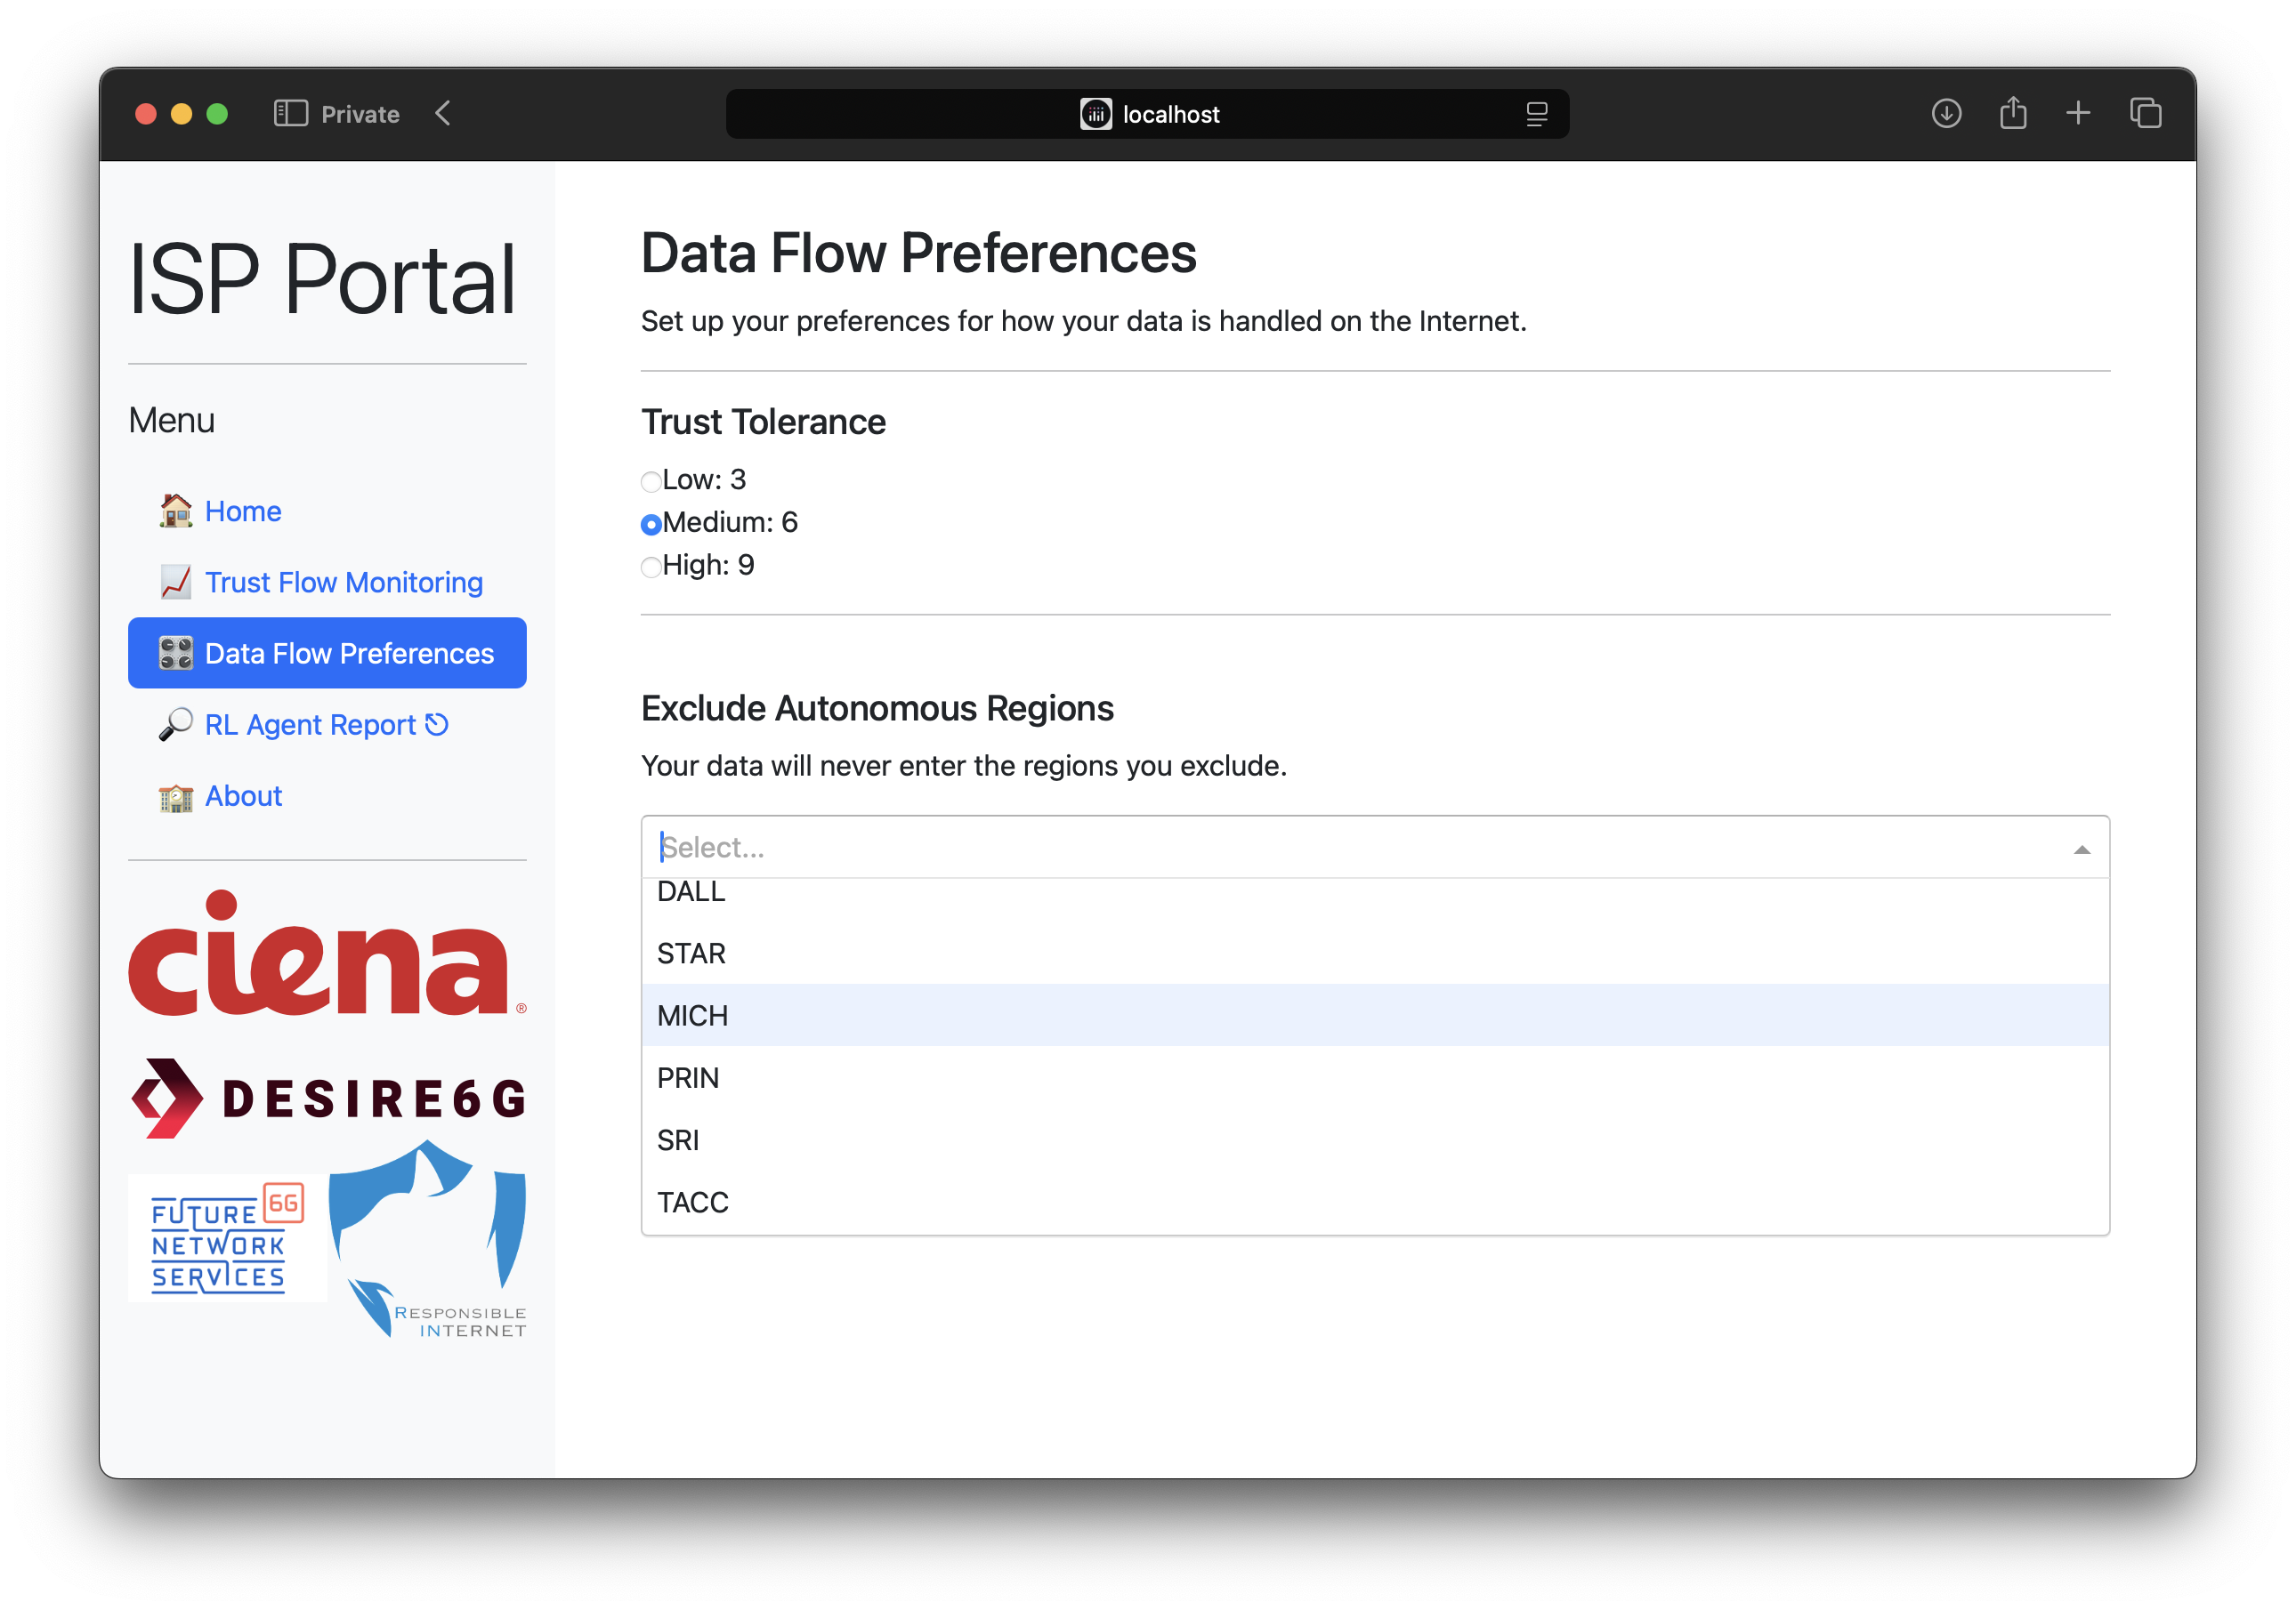
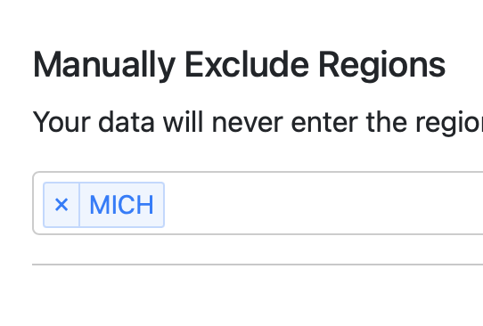
User Intent-driven network Control
Demo: scenario I

Slide 20
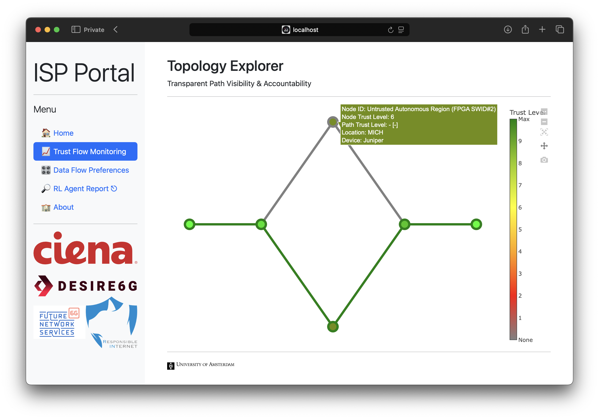
User Intent-driven network Control
Demo: scenario I

Slide 21
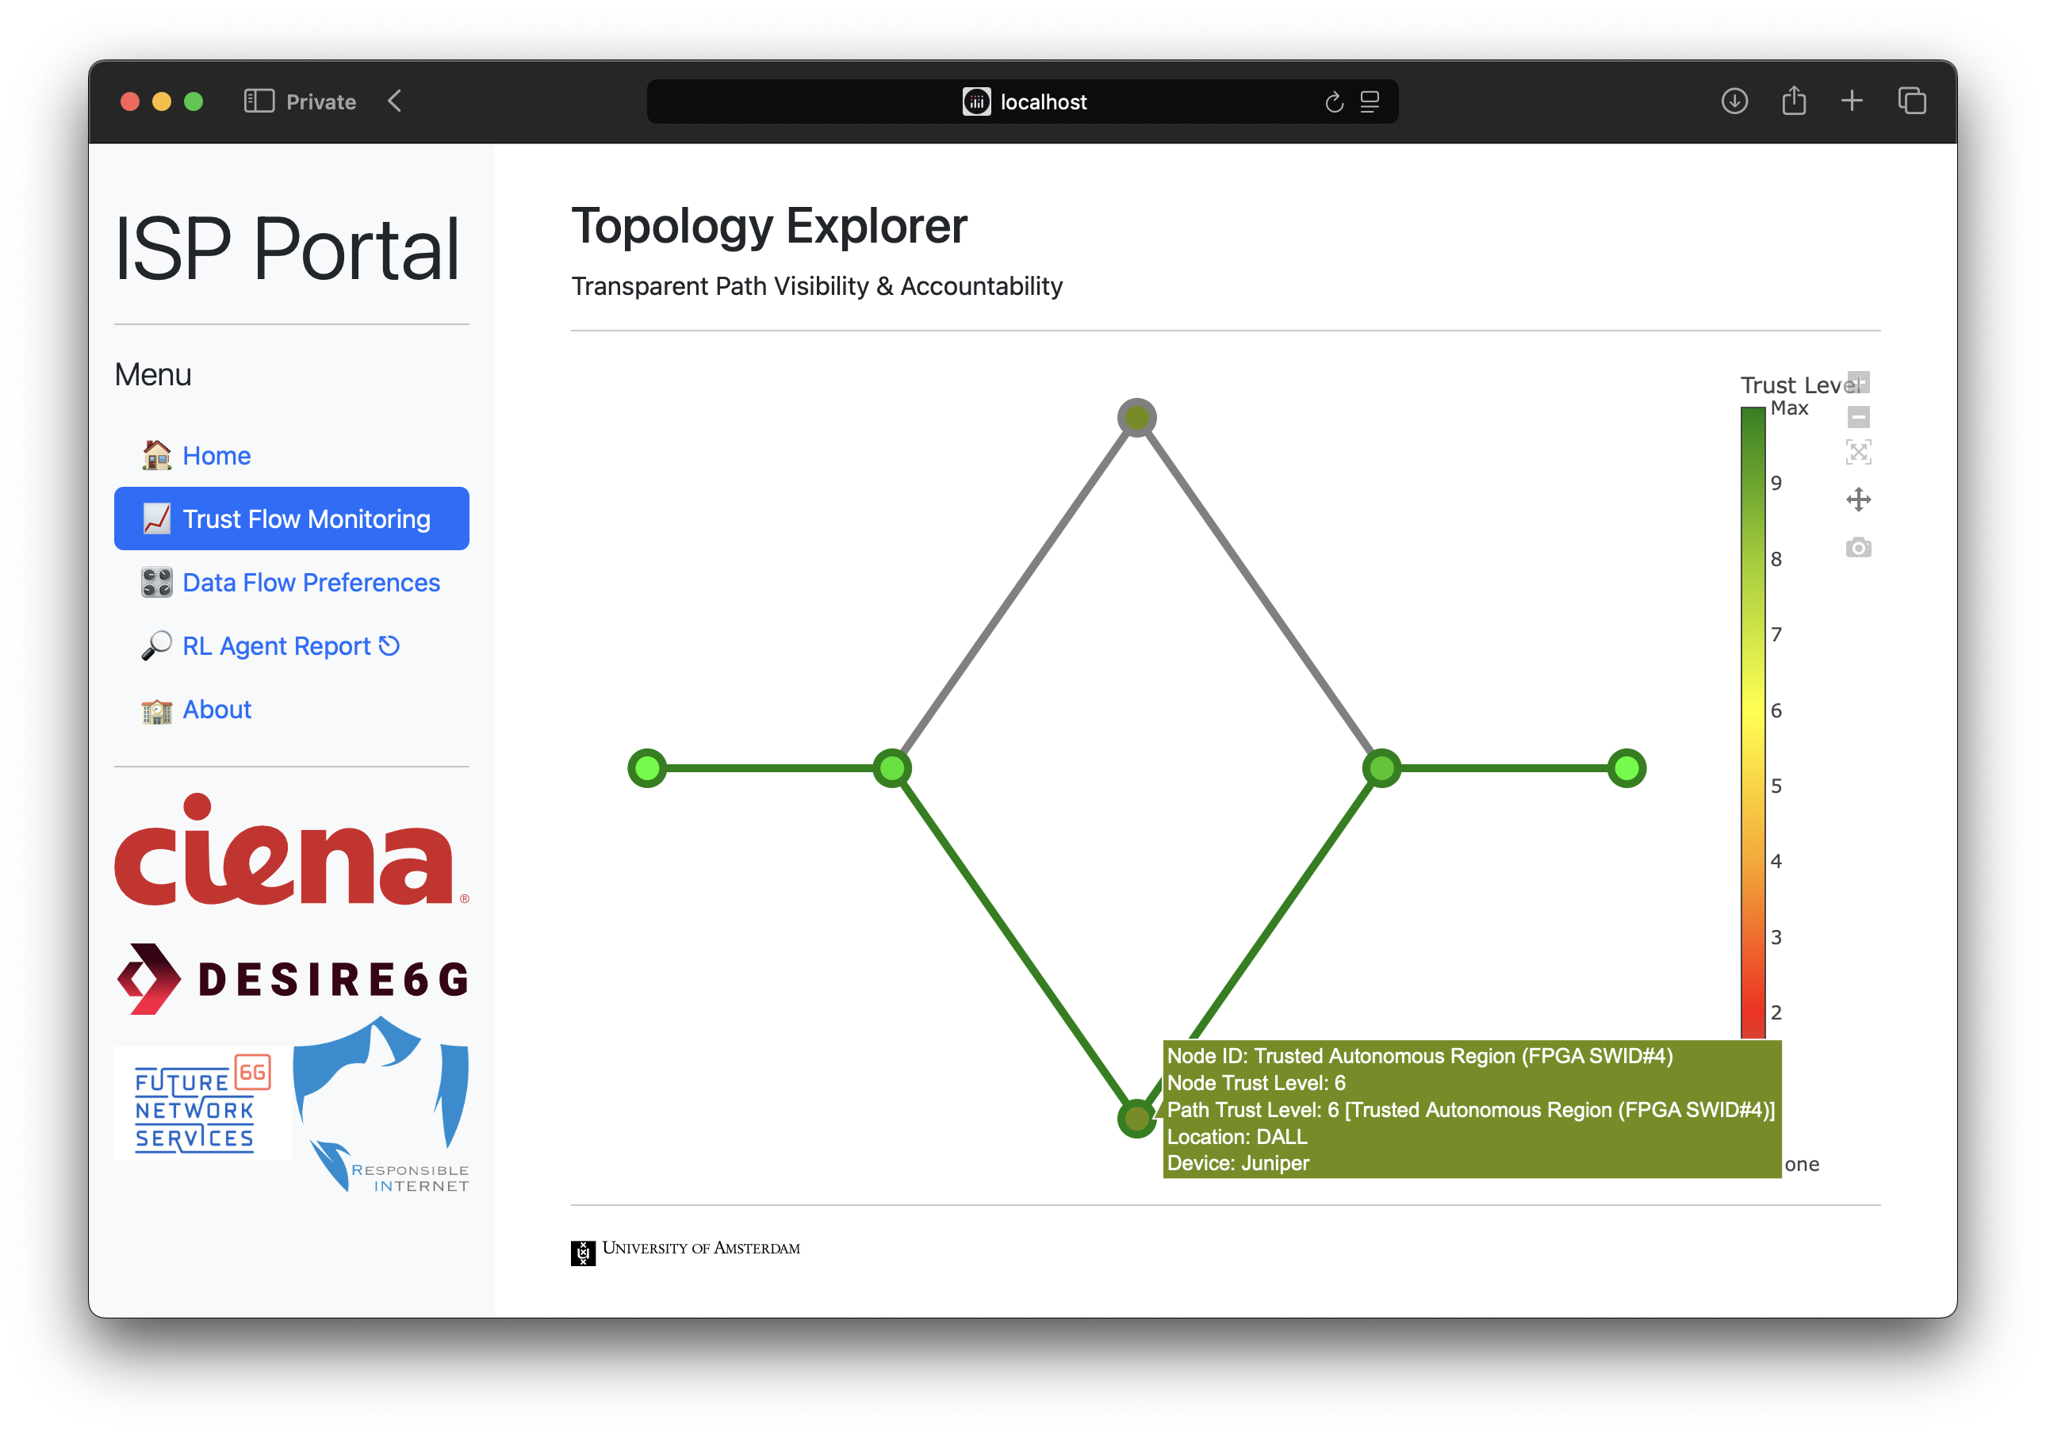
User Intent-driven network Control
Demo: scenario I

Slide 22
Contributions
INT, IN-RL and IBN for a Responsible Internet
Empowered Users via Transparency & Control
Enabled users to specify their trust preferences and then verify the data path integrity in real-time using In-band Network Telemetry (INT).
In-Network RL Path Optimization in the Data Plane
Integrated Reinforcement Learning (RL) agents directly into the programmable data plane, enabling autonomous, security-aware flow steering decisions, without control plane intervention.
Validated in a Realistic Infrastructure
Deployed and tested on the FABRIC testbed programmable switches, demonstrating the feasibility of a secure, intent-driven data flow control and dynamic path optimization.

Slide 23
Thank you
Anestis Dalgkitsis, Jose Zerna Torres, Angelos Dimoglis, Luca Cetino, Marios Avgeris, Chrysa Papagianni, Paola Grosso, Cees de laat

